Slide 1

Creating Your First ERC 20 Token!

Slide 2
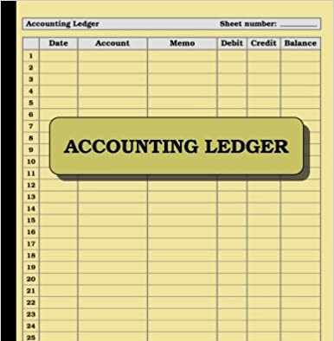
Blockchain
A distributed and decentralized ledger
A ledger is simply a logbook of transactions which tracks when money is sent from one account to another
The key difference between the ledger at your bank and a blockchain such as bitcoin is decentralization

Slide 3

Ethereum
Ethereum extended blockchain beyond handling simple transfers of money from one party to another
Ethereum transactions allows for any arbitrary code execution to be considered a transaction
These complex transactions are executed by smart contracts

Slide 4
Smart Contracts
Combination of API + Database
Just like an API, it has methods a client can call
Unlike an API it has its own persistent storage as well
The most common programming language for Smart Contract is called Solidity (looks a lot like JavaScript)
Tokens (Fungible or NFTs) are implemented by smart contracts

Slide 5
Tokens
A digital asset defined by a smart contract
The token smart contract:
Stores the token balance per user
Defines the logic for transferring tokens from one user to another
Stores any metadata e.g. the token name, symbol etc.

Slide 6





Fungible vs Non-Fungible Tokens
Replace the word fungible with interchangeable
Fungible tokens are like dollars, non-fungible tokens (NFT) are like baseball cards
ERC-20 is the standard for fungible tokens on Ethereum

Slide 7

Wallets And Addresses
Wallets hold digital assets including tokens
The most popular wallet for Ethereum is MetaMask which is a browser extension
A wallet will have an address, which is essentially its identifier
Addresses look like this:
0x18B733cE9661190fFE3728561B9dCc0F60f8c694
0x0823cA4422DfE3aC8e3cC66ceb7a1d4EA2eea519

Slide 8
MetaMask Token Demo
Show token balances
Show transfer of tokens

Slide 9
Project Setup
Prereqs
Node must be installed
Install Remixd package globally
npm install -g @remix-project/remixd
Clone Repo
Run remixd -s <LocalRepo Absolute Path>\contracts
Run Remix in the browser (https://remix.ethereum.org) with localhost option

Slide 10
Hello World Example
helloWorld.sol

